Slide 1
Artist In Residence
Teaching Artist Directory

Slide 2
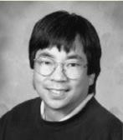
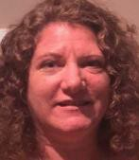
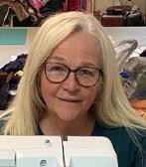
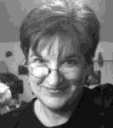
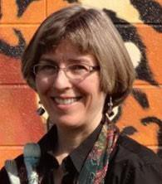
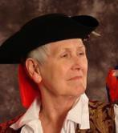
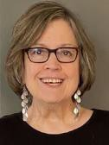
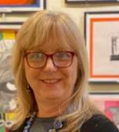
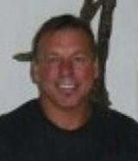
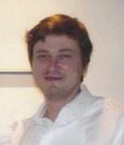
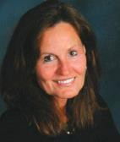
Teaching Artists
Click the artist’s name or image below to be taken directly to more details about that artist.
See more artists on the next page.
Patrick Adachi
Media Arts (Video)
Jane Holt
Visual Arts (Painting, Mosaic, Pottery, Fabric Arts, Puppet Theater)
Peggy Black
Media Arts (Fabric Dying & Mark Making)
Terry Johnson
Visual Arts (Mosaic)
Deb Bunnell
Visual Arts (Illustrations, Paintings, Murals)
Jan Kinney
Folk Arts (Storyteller)
Linda Callaway
Visual Arts (Mural,
Painting, Mixed Media)
Joy Knepp
Folk Arts (Jewelry
& Sculpture)
Peter Frantz
Interdisciplinary Arts (Sculpture & Video)
Evgeny Krayushkin
Visual Arts (Painting & Woodcarving)
Rita Haldeman
Visual Arts (Painting)

Slide 3
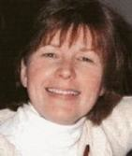
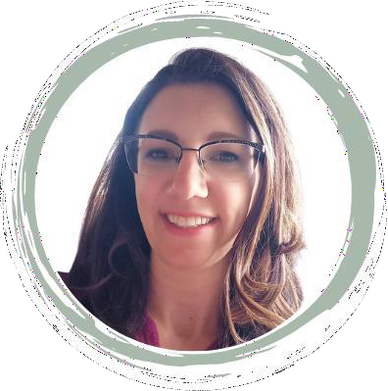
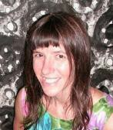
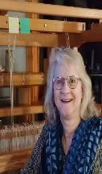
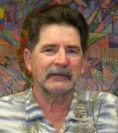
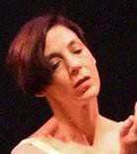
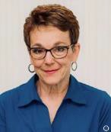
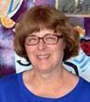
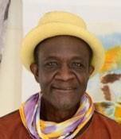
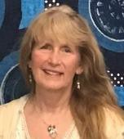
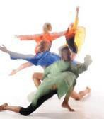
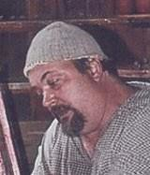
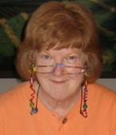
Teaching Artists
Click the artist’s name or image below to be taken directly to more details about that artist.
Click here to see a list of Guest Artists.
Lynne Magee
Visual Arts (painter)
Amy Roadman
Visual Arts (Pottery, Printmaking, Drawing, Painting, Mixed Media)
Laura Jean McLaughlin
Visual Arts (Murals, Sculpture, Ceramics)
Sandra Trimble
Fiber Arts
Thomas McCarty
Visual Arts (Murals,
Sculpture, Ceramics)
Ann Van Kuren
Dance (Choreographer)
Bridget Mayak
Visual Arts (Pottery,Painting,
Photography, Weaving, Welding)
Sharon Wall
Visual Arts (Mixed Media Fiber Arts)
Saihou Omar Njie
Textile Arts (Batik)
Susan A. Wilson
Visual Arts (Clay, Pottery & Photography)
Allison Popieski
Dance (Attack Theatre)
Bob Zabrosky
Visual Arts (Ceramics & Jewelry)
Kathy Trexel Reed
Visual Arts (Paper)

Slide 4
Patrick Adachi
Artist list
Media Arts - Video Artist
Artist Contact:
2617 Pleasant Valley Blvd Altoona, PA 16602
814-944-2031
Media Arts:
Video
Age Range for Residencies:
Elementary, Middle/Junior, High School, Adult
References:
Lou Leopold 814-696-0530
John Bohn, Starfleet Production,
814-942-7827
I believe that anyone can create art, regardless of any physical, mental or social barriers. I enjoy the close relationships between history, science, art, and helping people become aware that through art-making one can traverse boundaries. My residencies are adaptable to many different groups of people and their skill levels and concerns. From learning how to create detailed pieces of jewelry to large metal sculpture, I aim to re-connect students within their current curriculum in a new light. In one of my residencies with students studying North American Indians, we created a Totem pole out of metal shapes, wood, and paint. Fusing their studies of Native American culture with their individual beliefs, students represented their current world with animals and symbols by their design. It is always my goal to help people to learn to use their imagination and find their own talents and self-confidence.

Slide 5
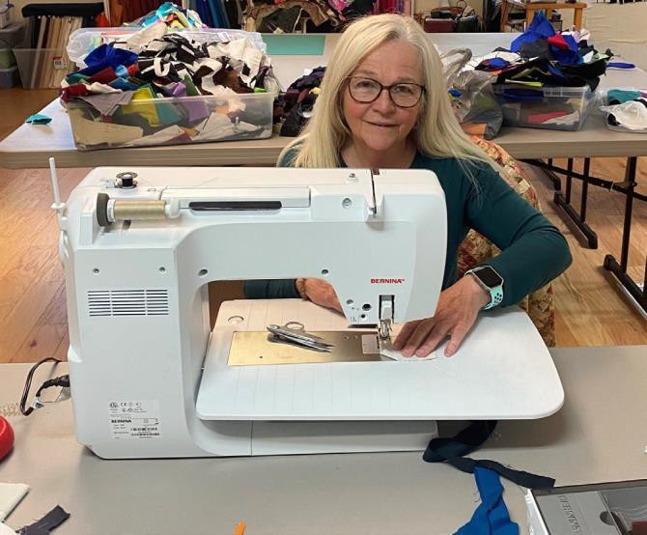
Peggy Black
Artist list
Media Arts – Fabric Dying / Mark Making with Colorants or Thread
Artist Contact:
412 Pelesky Road, Boswell PA 15531
814-279-5067
pblack1953@gmail.com / www.peggyblackquilts.com
Age Range for Residencies:
Elementary, Middle/Junior, High School, Adult
References:
Upon Request
▶ Margaret Black is a full-time textile studio artist in rural Jenner Township, Pennsylvania. Although she is a retired accountant, a sewing machine has been central to her life since the age of eight. As a 4-H leader, she has taught basic sewing and tailoring for over 30 years. In the mid 1990’s she discovered a quilter named Nancy Crow and began following her work. It was not until 2011 that Margaret ventured to the Crow Barn Art Retreat Center to begin her studies into quiltmaking as art. She has studied with Nancy for the past nine years. Among other teachers who have facilitated Margaret’s artistic journey are Lisa Call, Claire Benn and David Hornung.

Slide 6
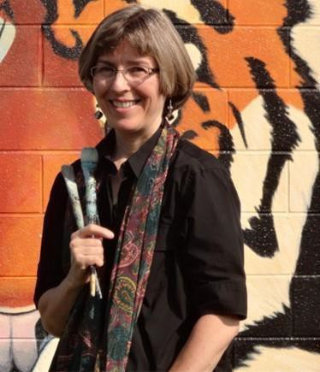
Deb Bunnell
Artist list
Visual Arts – Illustrations/ Paintings/Murals
Artist Contact:
772 Clark Street
Hollidaysburg, PA 16648
debbunnell@rocketmail.com
814-696-1981
Media Arts: Illustrations/Paintings/Murals Age Range for Residencies:
Early Childhood, Elementary,
Middle/Junior, & High School
References:
Upon Request
Deb Bunnell has been swept away by the transformative power of wall murals ever since her parents allowed her to crayon an entire zoo onto her bedroom walls as a child. After degrees in Art/Liberal Arts from Millersville University, and Illustration from the University of the Arts (Philadelphia), she has worked as an illustrator, commissioned painter and mural painter. Most of her murals are in schools, from preschool through high school. The mural can express any subject matter desired by the school while adding warmth and excitement to a plain wall. Students can brainstorm images and design, help transfer the sketch to the wall, and learn how to handle acrylics while painting the mural. For a residency involving more personal sized work, Deb enjoys teaching colored pencil painting or acrylic painting. The focus on the personal sized paintings is gaining confidence in the medium in order to develop each student's individual expression.

Slide 7
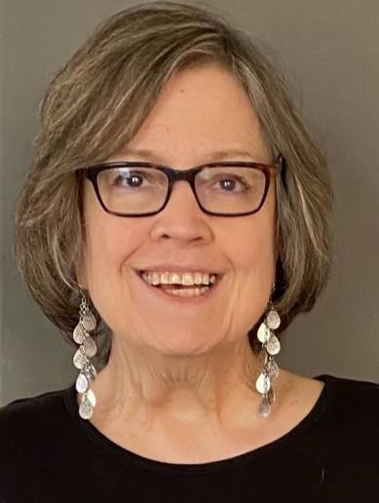
Linda Callaway
Artist list
Visual Arts – Mural, Painting, Mixed Media
Artist Contact:
615 West Penn Street Bedford PA 15522 lccallaway63@gmail.com
918-351-8918
Age Range for Residencies: Early Childhood, Elementary, Middle/Junior, & High School
References:
Upon Request
Linda Callaway taught at public schools for over 30 years, mostly elementary art but is experience in all age levels. Retired from Sadler Arts Academy, Muskogee, OK. Sadler’s curriculum is literature based and art is taught in the classrooms as well as the art room. Callaway states “I love introducing students to art techniques and inspiring their creativity. Children’s art has such charm and freedom”.

Slide 8
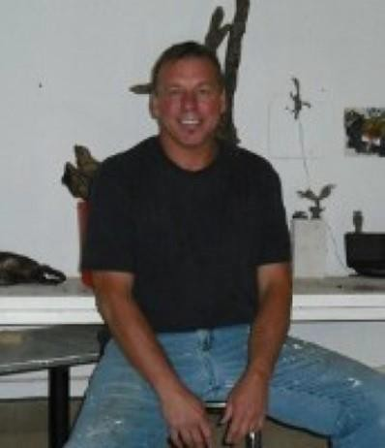
Peter Frantz
Artist list
Interdisciplinary Arts - Interdisciplinary
Artist Contact:
322 W 18th Street
Tyrone, PA 16686
814-931-1430
pfsculptor@gmail.com
www.peterfrantz.com; www.fragilepeace.org; https://peterfrantz.wixsite.com/student
Age Range for Residencies:
Middle/Junior, High School, Adult
References: Dr. Kevin Richards, PA Academy of the Arts, 215-805-0471 Daniel Miller, PA Academy of the Arts, 215-972-2027
My primary tools for residencies are sculpture and video, and the process is twofold. I make use of traditional methods and forms (sculpture) combined with digital tools (video), creating a bridge between the historic culture of art and the electronic age we live in (and all children are immersed in). Children of all ages have an innate ability to translate active and eclectic imaginations into compelling art; art as a dialogue with memory and environment, the story told to us by ourselves, where the ending is unknown. It is the wonder of art and underlines the video portion of the residency. We build sculpture (generally found materials), and as we do, we begin to wonder what this thing we have created means to us, and by default, to other viewers. The sculpture, which tends towards abstraction, is a process of allowing the students to resist the forms we know well and expand their art into areas that fit no previous experience, using a short survey of contemporary art as a starting point. A digital video camera is set up to record the art making process, and the documentary is directed by as many students as wish to participate. Secondarily, interviews with the artists are held, where they are encouraged to discuss their art, their thoughts and what the process meant to them. It is ALWAYS fun and extremely interesting, and the subsequent viewing of the documentary never fails to provide unexpected insights.

Slide 9
Rita Haldeman
Artist list
Visual Arts - Painter
Artist Contact:
1000 Deveron Court, Jeannette, PA 15644
Home phone: 724 744- 4674
rkintheloop2@netscape.net
ritahaldeman.com
Age Range for Residencies:
Early Childhood, Elementary, Middle/Junior, & High School
References:
Mr. Drew Banas, Loyalhanna Watershed, 724-238-7560 Mrs. Lisa Ferrence, St. Barbara Fine Arts Com., 724-864-2838
Rita Haldeman attempts to have students look at, study and paint the life around them, taking special notice in color and true light. Haldeman’s paintings go beyond recording realistic details: her goal is to capture a subject’s mood. She was chosen to paint the first limited edition print, Loyalhanna Springtime, for the Loyalhanna Watershed Association, and has received many awards, including First Prize in the Three Rivers Arts Festival in Pittsburgh .

Slide 10
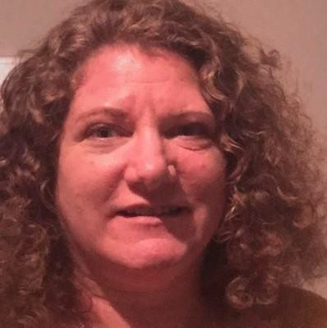
Jane Holt
Artist list
Visual Arts – Painting, Mosaic, Pottery, Fabric Arts, Puppet Theater
Artist Contact:
158 Humbert Road, Markleton PA 15551
814-233-8801
janethepaneart@gmail.com
Age Range for Residencies:
Early Childhood, Elementary, Middle/Junior, & High School
References:
Upon Request
W hat is a Crankie?
A Crankie is a combination of artistry, theatrics, puppetry, and fun. The very first of mobile entertainment, a Crankie theatre is a box with two spools inside. The spools have handles that can be “cranked” to bring movement to an illustrated scroll that is wound onto the spools. In the 19th century, these devises had many names but were often referred to as moving panoramas.
Near where I live in South-west Pennsylvania we have “Crankie-fest” in which the best Crankies perform their craft.
I got the Crankie bug four years ago and have been created new shows with my students every year since careful
it’s quite contagious.

Slide 11
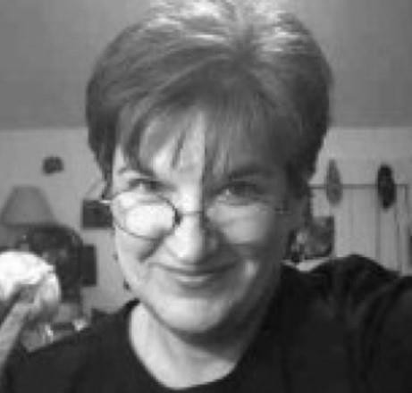
Terry Johnson
Artist list
Visual Arts – Mosaic Artist
Artist Contact:
P.O. Box 239 Lemont, PA 16851
814-777-1480
terryjtiles@aol.com Age Range for Residencies:
Elementary, Middle/Junior, High School, Adult
References:
Stephanie Hosier, Galaxy Arts in Education CIU 10,
Assistant Director, 814-237-3003
Barbara Wertz Leiden, Hollidaysburg High School,
Art Teacher, 814-695-4426
With my MFA, I chose to pursue a studio career within my medium of choice--ceramics. The creative potential of clay was too vast to give me a clear artistic direction. I elected to master in tile making. Tiles can be small and precious or monumentally awe-inspiring, two- or three-dimensional, humorous, serious, commemorative, a solitary pursuit or a community project. In short, I have joyfully indulged in 20+ years of exploring tiles without yet finding the area limiting. Teaching the art of tile making has been the richest benefit. In a workshop, I feel privileged to join other minds experimenting and creating.

Slide 12
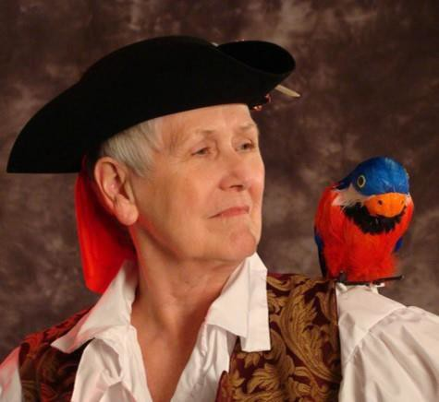
Jan Kinney
Artist list
Folk Arts - Storyteller
Artist Contact:
1900 16th Ave. Altoona, PA 16601
814-943-1080
jan.kinney@verizon.net Age Range for Residencies:
Early Childhood, Elementary, Middle/Junior,
High School, Adult, Senior
References: Robert W. Fisher, Bellwood Middle School,
814-742-2273
Penny Blazer, Penns Valley Elementary School,
814-422-8824
There is nothing more important than educating our children. No art form communicates more effectively than storytelling; it crosses all racial, age, social, and gender barriers. Storytelling in education makes miracles happen. In my residencies I tell stories, teach storytelling, build communication skills, discuss story genres, and cultural storytelling styles and traditions. In addition I help the students learn valuable life lessons. My residencies are fun and educational. I have a Bachelor's Degree in Library Science from Clarion University which has helped me find and research stories; I have a Master's Degree in Curriculum and Instruction from Penn State University which helps me apply what I learn to school situations. And last, I believe storytelling teaches us to be human. Of all the lessons a child must learn, I believe this to be the most important.

Slide 13
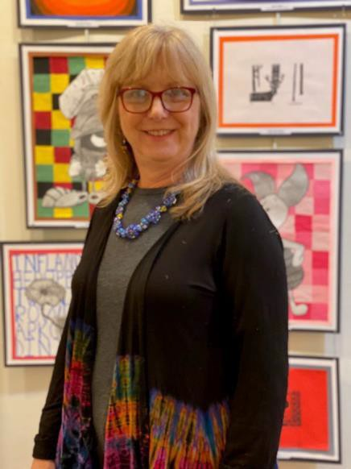
Joy Knepp
Artist list
Folk Arts – Jewelry and Sculptures
Artist Contact:
1616 Short School Road, Somerset PA 15501
814-521-3047
joy.knepp@gmail.com Age Range for Residencies:
Early Childhood, Elementary, Middle/Junior,
High School, Adult, Senior
References:
Upon Request
Joy Knepp uses flame working techniques in her work which involves manipulating rods of glass with a torch to create glass beads that she uses to make jewelry and small sculptures. She guides students, middle school, high school or adults in a step-by-step journey with working in glass as well as using inspirations from nature to design jewelry incorporating glass, metals, and natural objects. Ms Knepp is a retired k-12 art educator from Shanksville-Stonycreek School District and has earned a B.S. and B.A. in art and education from Pennsylvania State University. She continued post-graduate work from several institutions including Frostburg State University of MD, California University of PA and the University of the Arts in Philadelphia. She has studied and taught techniques in Glass at Touchstone Center for Crafts, Farmington, PA. She has also studied at Pittsburgh Glass Center, Goggleworks, Reading, PA and many other workshops affiliated with the International Society of Glass Beadmakers. Her work has been exhibited and sold in galleries and art centers in the region.

Slide 14
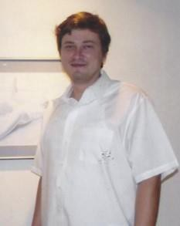
Evgeny Krayushkin
Artist list
Visual Arts – Painting, Woodcarving
Artist Contact:
P.O. Box 125
Calvin, PA 16622 Zhe8ka@yahoo.com
Age Range for Residencies: Early Childhood, Elementary, Middle/Junior, High
School, Adult, Senior
References: References available upon request
My idea of teaching is more of an assistance. (or, I view teaching as more like assisting.) I will assist the students in their development of a) the individual vision, and b) a personal narrative as a prelude to developing a voice/style. Art is about the journey and the discovery (whether external or internal) and ultimately, my goal is to teach that concept. Art is an individual journey; it is in the process, in the action, in the movement, in the struggle, and in the search -- the acts of an individual journey. I am a mental health therapist by trade, and I believe in the therapeutic aspects of art. Art can heal, inspire, and tell some really great stories! I am open to all age groups - the experiences of expression, inspiration and discovery are not defined by our age or ability.

Slide 15
Lynne Magee
Artist list
Visual Arts – Painter
Artist Contact:
861 Sugar Run Road
Altoona, PA 16601
814-943-6367
mmagee7920@atlanticbb.net lyneeamagee.weebly.com
Age Range for Residencies:
Early Childhood, Elementary, Middle/Junior, High
School, Adult, Senior
References: Colleen Montrello, ARC, 814-695-5994
Stephanie L. Hosier, Galaxy, 814-237-3003
My educational background includes a bachelors degree in studio art and art education from William Smith College and graduate studies at SUNY Brockport and Penn State University. I have seven years of teaching experience in the public schools of New York and Pennsylvania. As a resident artist for well over ten years, I talk to students of all ages about my life as a painter, discuss the history of the medium to be used, and facilitate a painting experience. Sometimes that experience is with watercolor. Students work with painting techniques and design theory. Members of the core group create individual watercolor paintings or work in groups to create large watercolor collages for permanent installation. Other times I facilitate the design and creation of permanent wall murals using latex paints. My residencies make ties with the Pennsylvania Academic Standards, not just with the arts & humanities, but also with science, history, math and language arts.

Slide 16
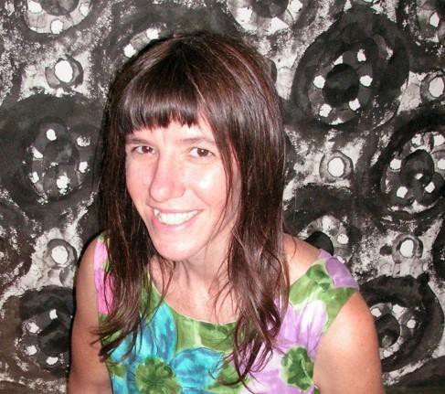
Laura Jean McLaughlin
Artist list
Visual Arts – Murals/Sculpture/Ceramics
Artist Contact:
Laura Jean Mclaughlin
2 Ann Street, Pittsburgh, Pa 15225
412 951-6133
Ljmclay@hotmail.com www.laurajeanmclaughlin.com Age Range for Residencies:
Early Childhood, Elementary, Middle/Junior, High
School, Adult, Senior
References: Sherry Morningstar, The Village at Morrison's cove,
814-793-2104
Jennifer Anto, 724-238-3560
Working collaboratively with groups of students and adults (all ages) is truly amazing and yields memorable experiences and impressive pieces of artwork that will last for ages. It is my passion to make these experiences and artwork come into fruition by creating large-scale mosaic murals, mosaic sculptures, personal mosaics as well as ceramic artwork along with the participants involved and provide them with new skills, beautiful artwork and lasting memories. Working collaboratively with groups of students and adults (all ages) is truly amazing and yields memorable experiences and impressive pieces of artwork that will last for ages. It is my passion to make these experiences and artwork come into fruition by creating large- scale mosaic murals, mosaic sculptures, personal mosaics as well as ceramic artwork along with the participants involved and provide them with new skills, beautiful artwork and lasting memories.

Slide 17
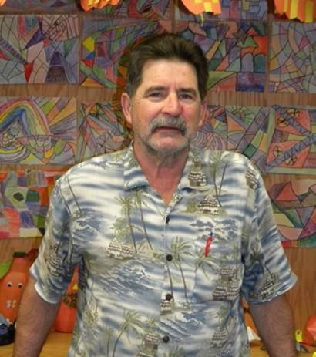
Thomas McCarty
Artist list
Visual Arts – Murals/Sculpture/Ceramics
Artist Contact:
113 New Road Lilly, PA 15938
814-886-4221
Age Range for Residencies:
Adult and Senior
References: Upon Request
I am a self-taught and self-employed sculptor. Due to a minimal amount of formal art education, my work is unhampered by convention and preconceptions, making it original and alive. I try to incorporate the natural beauty and design of the wood into my artistic statement. My greatest joy comes from seeing students light their creative fires through hands on work on their own sculpture. I conduct workshops and residencies in sculpture. Students are taught the basics of sculpture and are encouraged to express their own unique creativity through it. Student's design, create, and carve their own projects. They are also able to work collaboratively with me on one of my sculptures. I instruct students in the “hands-on” approach to the creative process and expressing their own individuality. I also conduct introductory slide lectures and sculpture demonstrations to enhance student art appreciation.

Slide 18
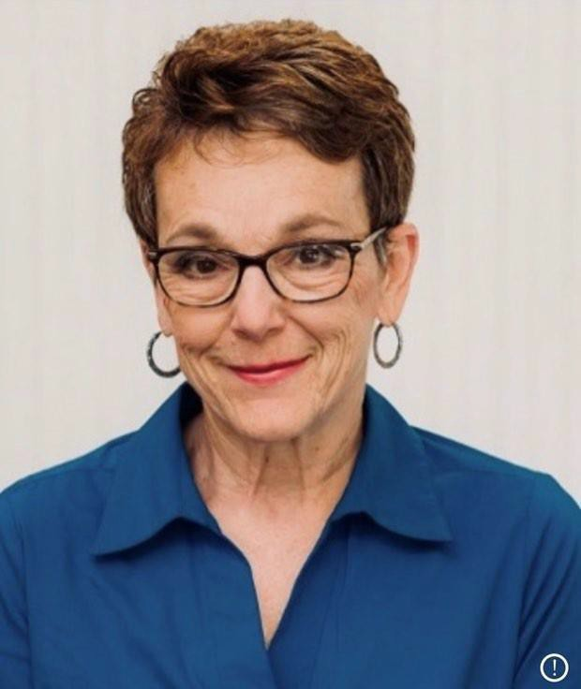
Bridget Mayak
Artist list
Visual Arts – Clay Pottery and Tiles
Artist Contact:
414 N Rosina Avenue, Somerset PA 15501
814-442-8957
mayak2@hotmail.com Age Range for Residencies:
Elementary, Adults, Seniors
References:
Upon Request
▶ The experience of teaching art in the public school system, as well as in various arts organizations has provided me with the ability to develop meaningful art curricula for all ages. My specialty is clay pottery and tiles.
▶ I love to incorporate art history and multi-cultural themes that are meaningful to participants. I also strive to incorporate a wide variety of materials, tools, and techniques into my lessons, with an emphasis on discovery, collaboration, and enrichment.

Slide 19
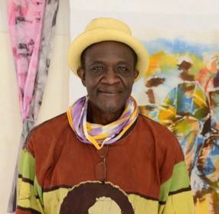
Saihou Omar Njie
Artist list
Textile Arts – Batik
Artist Contact:
www.footiyoo.wix.com/keurmakitaara
saihounjie@mac.com Age Range for Residencies: Elementary, Middle and High School
References:
Upon Request
Throughout his life and career, Saihou Omar Njie, aka SONJIE, has been educating and inspiring people with his craft. Known for his use of Batik-style art, dance, and mindfulness movement, he has developed his craft over the years in order to encourage and inspire others to be creative and innovative in their daily lives. On reflecting on his life and career, Saihou says, “Everyday I wake up, I’m in school.... School of Life, in which I am constantly learning something new about life and myself. And my experiences inform my art." In other words, the teacher is also a student, but he has been able to take the lessons he’s learned over the years to help inspire his own students in their creative endeavors.

Slide 20
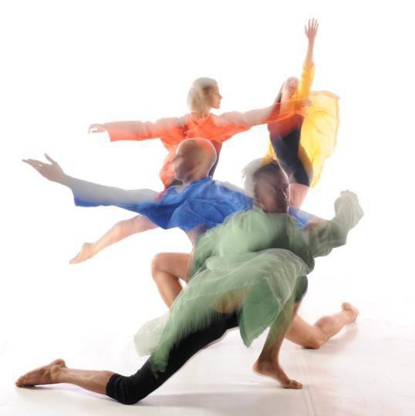
Allison Popieski
Artist list
Dance / Attack Theatre
Artist Contact:
212 45th Street, Pittsburgh PA 15201
allison@attacktheatre.com https://www.attacktheatre.com Age Range for Residencies: Elementary, Middle and High School
Seniors, Adults/Children with special needs
References:
Upon Request
Founded in 1994 by Michele de la Reza and Peter Kope as a collaboration between two dancers and a city, Attack Theatre fuses modern dance, original live music, and interdisciplinary art forms to create engaging dance performances. We create work at the intersection of art and community, resulting in productions that are personal, authentic, welcoming, and fearless.
Attack Theatre builds community with artists and audiences through the process and production of personal, accessible dance-based performance. Blending varied art forms with dynamic contemporary dance, Attack Theatre creates passionate portrayals of everyday life.
Through inherently collaborative and deliberately inter-dependent artistic and educational programs, Attack Theatre will continue to demonstrate its uniquely integrated approach to art and living to connect communities, artists and audiences in Pittsburgh and around the world.

Slide 21
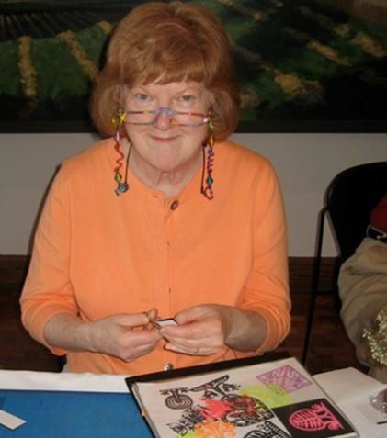
Kathy Trexel Reed
Artist list
Visual Arts - Paper
Artist Contact:
153 Black Bear Run Berlin, PA 15530
814-267-3183
kathytrexelereed@gmail.com Age Range for Residencies:
Elementary, Middle/Junior, & High School,
Adult, Senior
References:
Raymond Wolfe, Hollidaysburg Area School District,
814-695-1941
Debbie Aretz, McKee Middle School,
724-527-1591
Kathy Reed uses folding and cutting techniques to transform paper into pop-up, two- and three-dimensional creations in which positive and negative space enhance one another. She guides students in the creation of individual artistic expressions and/or interdisciplinary group projects. Reed has worked as a teacher in Department of Defense schools outside the United States. She holds a Baccalaureate degree from Gettysburg College and a Master of Arts from Michigan State University.

Slide 22
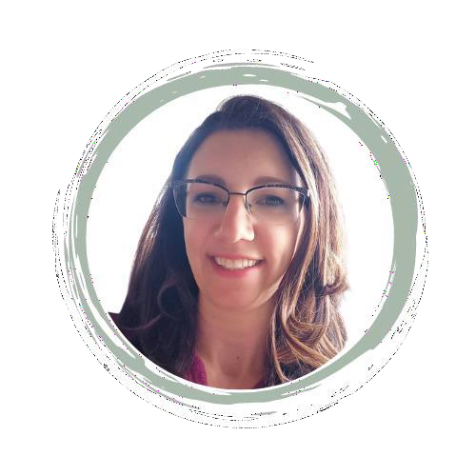
Amy Roadman
Artist list
Visual Arts – Pottery, Printmaking, Drawing, Painting, Mixed Media
Artist Contact:
467 Hoods Mill Road, Latrobe, PA 15650
724-572-7005
amyroadmanart@gmail.com www.amyroadman.com
Age Range for Residencies:
Early Childhood, Elementary, Middle/Junior,
& High School, Adult, Senior
References: Upon Request

Slide 23
Sandra Trimble
Artist list
Visual Arts – Fiber Artist
Artist Contact:
80 Old Gate Road, Penn Run, PA 15765
724-388-3773
sandye60@gmail.com Age Range for Residencies:
Early Childhood, Elementary, Middle/Junior,
& High School, Adult, Senior
References:
Upon Request

Slide 24
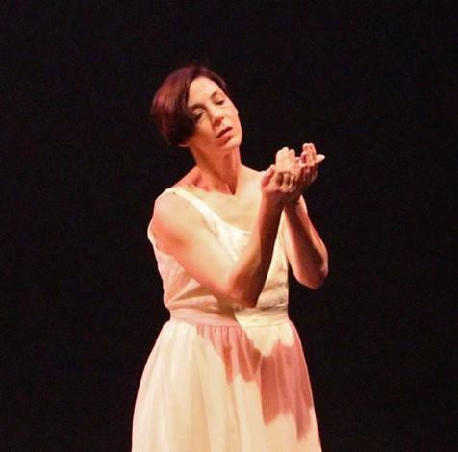
Ann Van Kuren
Artist list
Dance - Choreographer
Artist Contact:
103 E. Hamilton Ave. State College, PA 16801
814-238-5918
vandanceinc@gmail.com http://www.youtube.com/user/vandanceinc1
Age Range for Residencies:
Early Childhood, Elementary, Middle/Junior
& High School, Adult, Senior
References: Paulette Stratico, Loyahanna Elementary School,
724-836-2513
Lynn Cruse, McGhee Elementary School,
570-748-8822
With Ann Kuren, Students explore the elements and principles of dance to create and perform a unique movement piece of their own, inspired by an area of study in their curriculum, while schools address the PA Academic Standards for Arts & Humanities (in Dance). Recent topics include weather, air and aviation, Native American studies, Japanese folk tales, and writing stories. She has a B.A. in Dance/Mathematics from Butler University; and an M.A. in Dance Performance/Choreography, from Ohio State University. She has recieved the PCA Choreographer's Fellowship. In addition to being artistic director at Pennsylvania Dance Theatre for 10 years, she is the founder, of VanDance, Inc. and has broad touring/residency experience teaching at 41 elem. and middle schools, 4 high schools, 6 colleges through Feb. 2006, Stephens College, Penn State, Ohio State, professional schools; performed: throughout US/Europe.

Slide 25
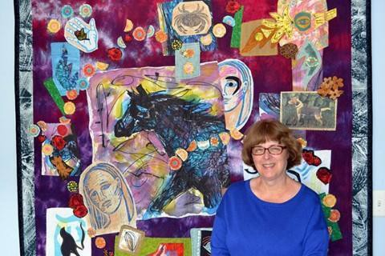
Sharon Wall
Artist list
Visual Arts – Mixed Media Fiber Arts
Artist Contact:
4515 4th Ave, Altoona PA 16602
814-946-5349
814-330-8057
stonehouseart@aol.com sharonwallart.com
Age Range for Residencies:
Elementary, Middle/Junior
& High School, Adult, Senior
References:
Andrew Neely, Altoona Area High School
(814) 946-8305
I am particularly excited to help students of all ages discover the artist within them. We all have so much going on in our lives that I feel art is the perfect way to express not only our hopes and dreams, but also our challenges. In art one has the opportunity to create a world of one’s own making. It is exciting also to be able to incorporate interdisciplinary subjects into both individual and group projects. Since I am a mixed media artist, I am experienced with a variety of media from painting to printmaking; from fabric to canvas; from small paper works to large art quilts. As a public school secondary art teacher I taught students with a full range of abilities from beginner to advanced placement. My students created over a dozen murals throughout their school, most with interdisciplinary themes. My own personal art focuses on painting and printing on fabrics that are then collaged together with various media.

Slide 26
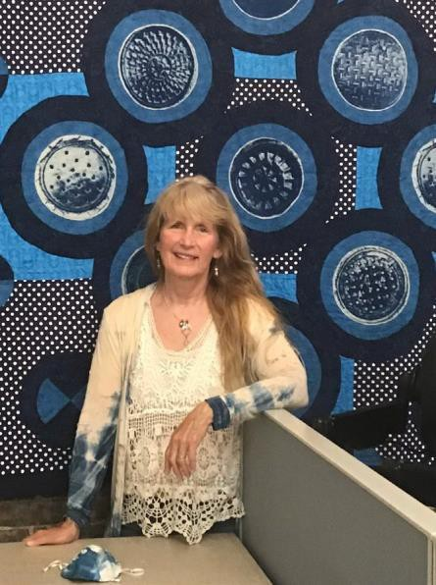
Susan A. Wilson
Artist list
Visual Arts – Clay, Pottery and Photography
Artist Contact:
1175 Fall Run Road, Rockwood, PA 15557
814-926-3199
wilsoncyanotype@gmail.com Age Range for Residencies:
Elementary, Middle/Junior
& High School, Adult, Senior
References: Jaci McCuster, Executive Director Laurel Arts 814-443-2433
Mike Rozgony, Principal Laurel Highlands Middle School 724-437-2865
Susan Wilson believes that the creative process is an important part of an individual's mental growth and well being leading to self discovery at all ages. She has taught in both public school and private settings working with multimedia including clay, gyotako printing, painting, drawing and the specialty of tying art to stories. The “Art of Being Kind with Your Flat Friend” telling a local story of Tori McClure, first woman to paddle the Atlantic, who was bullied on the playground and a boy named Eric Fee who defends her. With this empowering story students create a “flat friend”, are asked to do something kind and then take a selfie of the kind act. Printed images of these kind acts are displayed and encourage art and positive energy with the family and community.

Slide 27
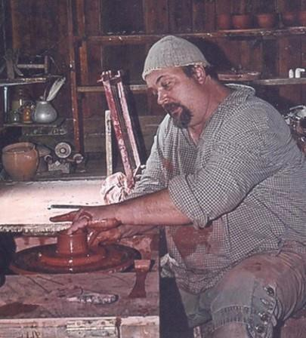
Bob Zabrosky
Artist list
Visual Arts - Ceramics, Jewelry
Artist Contact:
213 East Lloyd Street
Ebensburg, PA 15931
(814)-471-6997
Age Range for Residencies: Early Childhood, Elementary, Middle/Junior
& High School, Adult, Senior
References: Old Bedford Village, Bonnie
814-623-1156
My personal goal is to share my wealth of pottery-making experience with students and teachers. I have served as an art instructor for 28 years, and that experience allows me to teach the potter's wheel from a different perspective. My pottery program is geared toward teaching beginners. My other uses of clay include tile-making and murals that highlight school and community. Currently, I am the resident potter at Old Bedford Village where I specialize in historical interpretation of early Colonial pottery. Clay making is an important part of human growth through hands-on manipulation of creative ideas in a three-dimensional way.“ Bob also has an extensive background in jewelry making, such as creating cabochons (dome shaped, flat bottomed stones) from rocks in the rough. He also specializes in casting medals with the lost wax method.

